Slide 1
Fundamentals of Machine Learning
(20B12CS331) Odd Semester 2021 (5th Semester )
Dr. Mukesh Saraswat
(mukesh.saraswat@jiit.ac.in)
Computer Science and Engineering and Information Technology
Jaypee Institute Of Information Technology (JIIT), Noida

Slide 2
Fundamentals of Machine Learning
Statistics
Machine Learning
Probability
Calculus
Linear Algebra
Mathematical foundations of machine learning can facilitate
Creating new machine learning solutions
Understanding and debugging existing approaches
Learning about the inherent assumptions and limitations of the methodologies

Slide 3
Fundamentals of Machine Learning
Statistics
Machine Learning
Probability
Calculus
Linear Algebra
Linear Algebra
Data is represented as vectors and a table of such data is represented as a matrix.
The study of vectors and matrices is called linear algebra.
Probability
Quantification of uncertainty is the domain of probability theory

Slide 4
Fundamentals of Machine Learning
Statistics
Machine Learning
Probability
Calculus
Linear Algebra
Statistics
To understand the data more, some kind of descriptive statistics is required such as
Visualize the data
Plot a histogram for the data
Mine the data for getting some more information to find out where to go with the next stage of the machine learning process

Slide 5
Fundamentals of Machine Learning
Statistics
Machine Learning
Probability
Calculus
Linear Algebra
Calculus
To train machine learning models, some performance measure has to be maximized or minimized.
Many optimization techniques require the concept of a gradient, which tells the direction in which to search for a solution.
Calculus details the concept of gradients.

Slide 6
Linear Algebra
Linear Algebra
Linear Equation
Data Preparation
Data is represented as vectors and matrix forms.
To understand the relationships between the data, Linear Equations are used

Slide 7
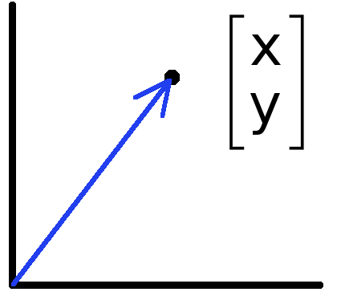
Vectors and Matrices
Data can also be treated as a vector.
Vector is a mathematical quantity that has magnitude and direction.
An array of numbers (data) is a vector. It can be a column in a dataset to be a feature vector.
Collections of ordered numbers that represent movements in space, word counts, movie ratings, pixel brightness, etc.
Points are just vectors from the origin

Slide 8
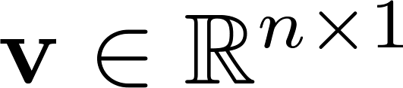
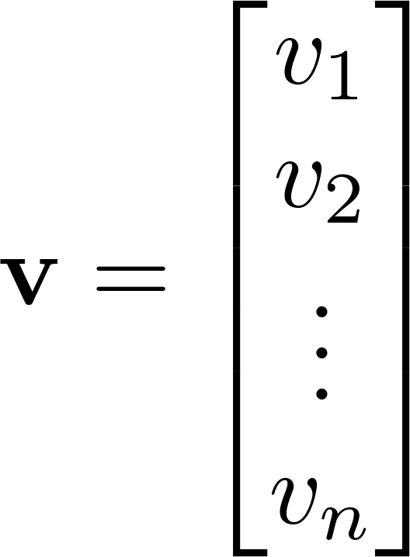
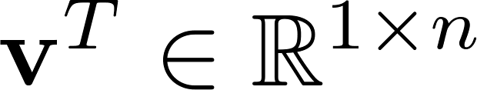
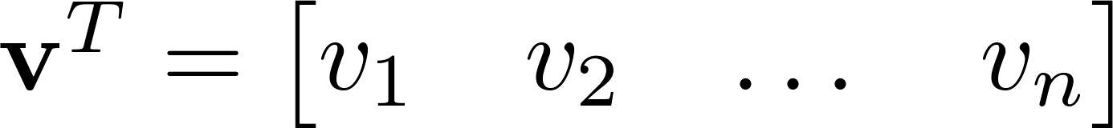

Vectors and Matrices
Let n be a positive integer and let denotes the set of real numbers, then is the set of all n-tuples of real numbers.
A column vector where
A row vector where
denotes the transpose operation

Slide 9
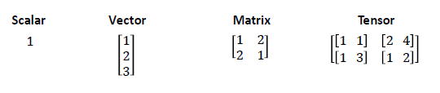
Vectors and Matrices
A matrix is a rectangular array of real numbers with m rows
and n columns. For example, a 3 x 2 matrix looks like this:
Tensor: Generally, an n-dimensional array where n>2 is called a Tensor. A matrix or a vector is also a valid tensor.

Slide 10
Vectors and Matrices
Represent the following data set in vector and matrix notation

Slide 11
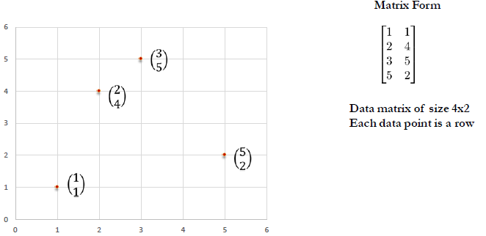
Vectors and Matrices
Represent the following data set in vector and matrix notation

Slide 12
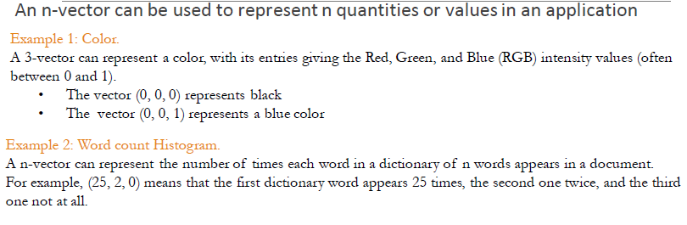
Vectors and Matrices

Slide 13
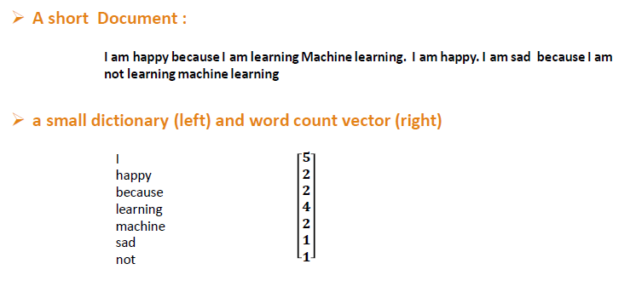
Vectors and Matrices

Slide 14
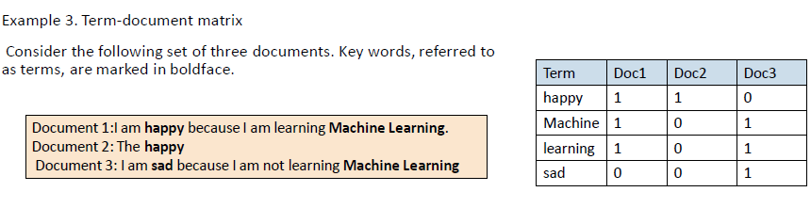
Vectors and Matrices

Slide 15
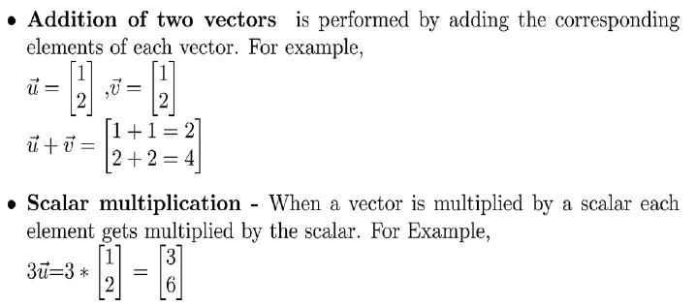
Operations on Vectors and Matrices

Slide 16
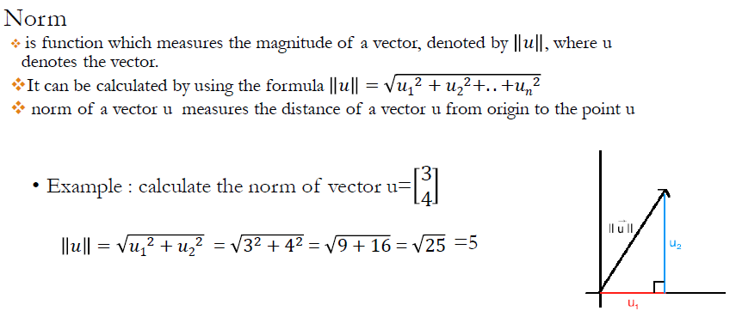
Operations on Vectors and Matrices

Slide 17
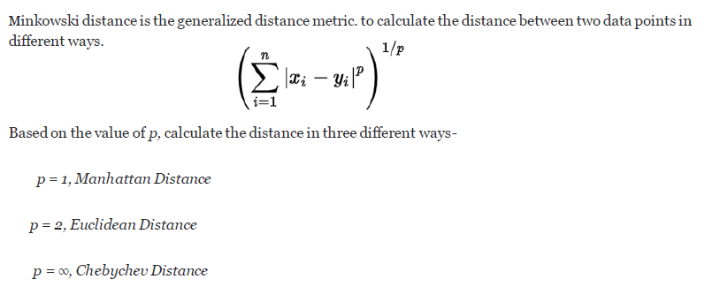
Operations on Vectors and Matrices
Different Vector Norms/ Distance Metrices

Slide 18
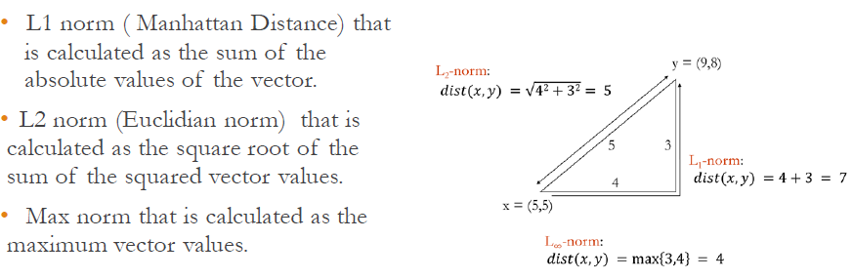
Operations on Vectors and Matrices
Different Vector Norms/ Distance Metrices

Slide 19
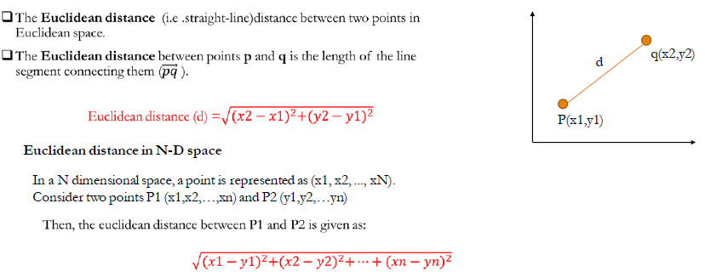
Operations on Vectors and Matrices
Distance measures for numeric data points

Slide 20
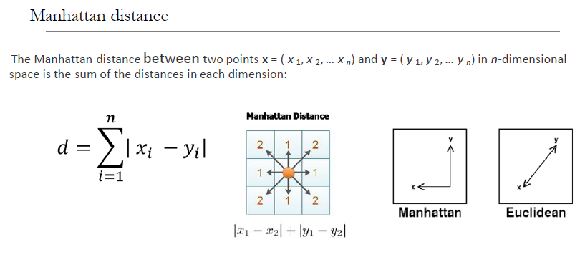
Operations on Vectors and Matrices
Distance measures for numeric data points

Slide 21
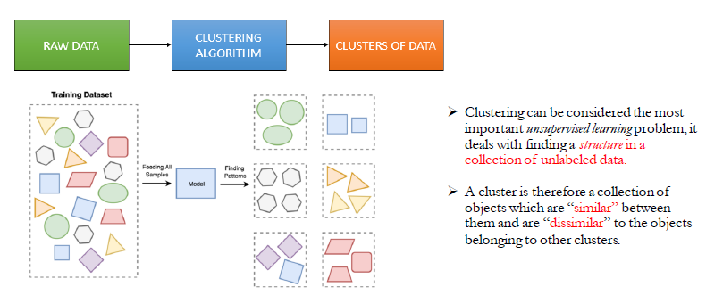
Application: Distance measures data
K-Means Clustering: an Unsupervised Learning

Slide 22
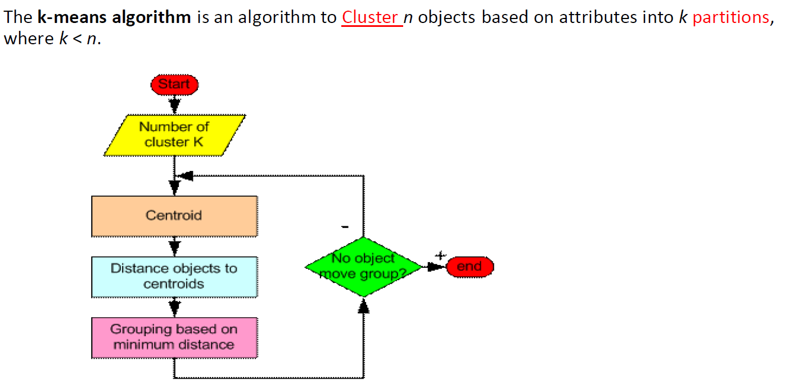
K-Means Clustering: an Unsupervised Learning
Source: https://people.revoledu.com/kardi/tutorial/kMean/Algorithm.htm

Slide 23
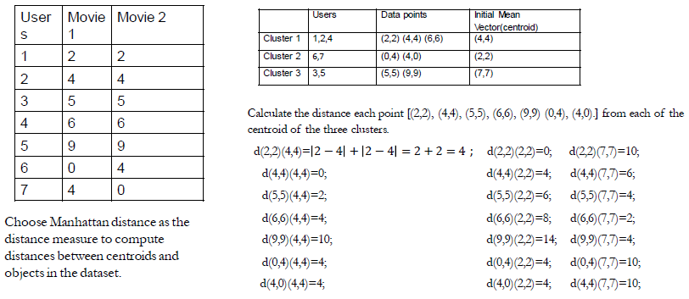
K-Means Clustering: an Unsupervised Learning
Movie Rating data (0-9)

Slide 24
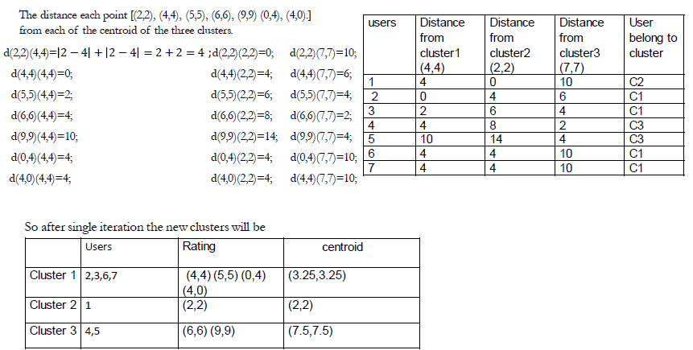
K-Means Clustering: an Unsupervised Learning
Movie Rating data (0-9)

Slide 25
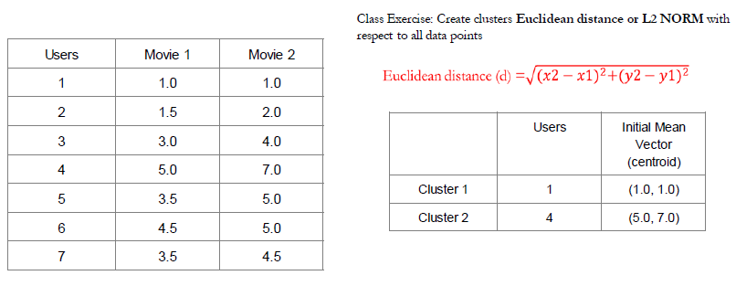
K-Means Clustering: an Unsupervised Learning
Movie Rating data (1-7)

Slide 26
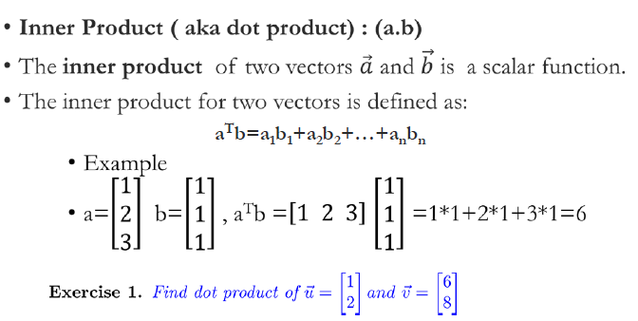
Inner Product (dot product) of Two Vectors
Algebraically, the dot product is the sum of the products of the corresponding entries of the two sequences of numbers.

Slide 27
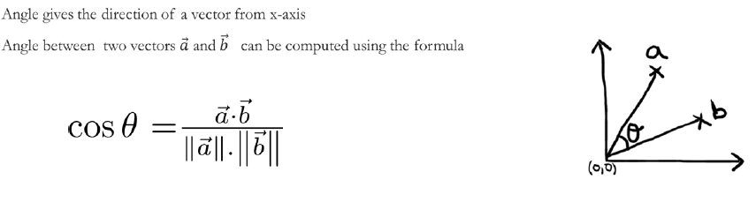
Angle between two vectors

Slide 28
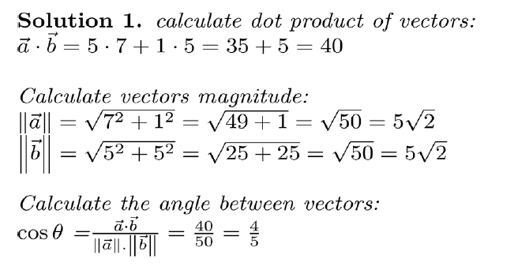
Angle between two vectors

Slide 29
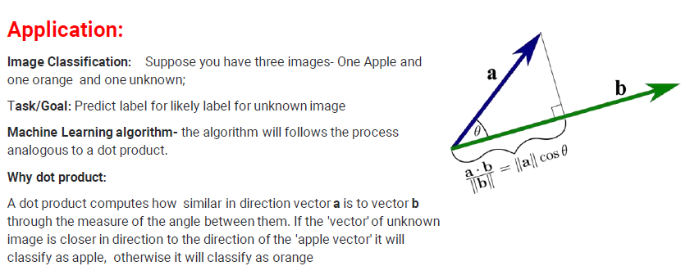
Inner Product (dot product) of Two Vectors

Slide 30
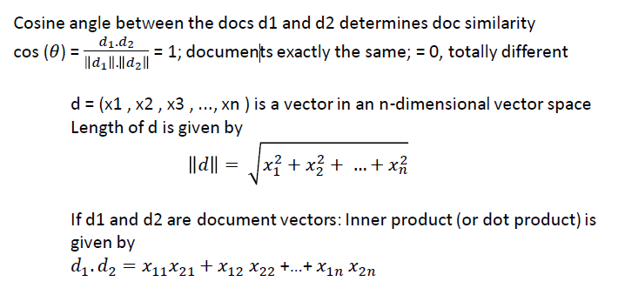
Inner Product (dot product) of Two Vectors
Application : Document Similarity –cosine Similarity measure

Slide 31
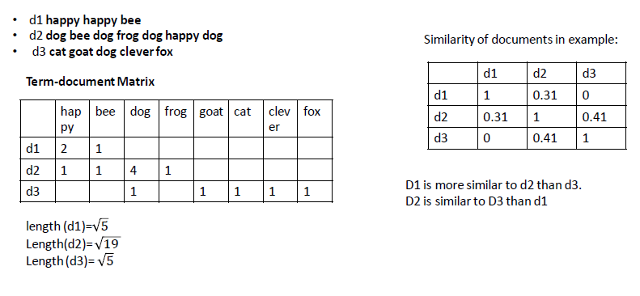
Inner Product (dot product) of Two Vectors
Application : Document Similarity –cosine Similarity measure

Slide 32
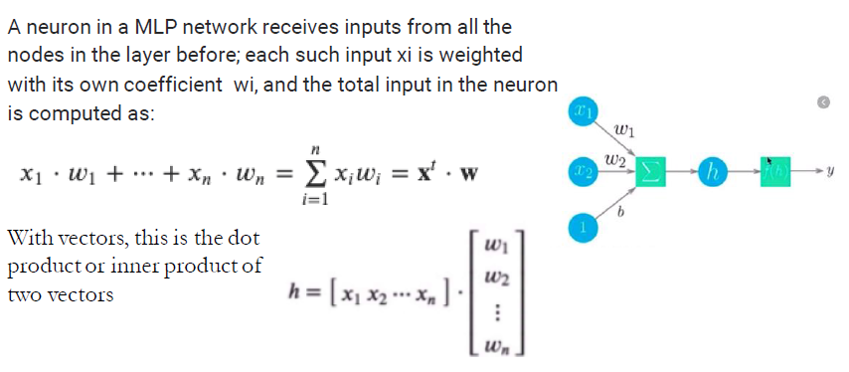
Inner Product (dot product) of Two Vectors
Application : Artificial Neural

